Slide 1
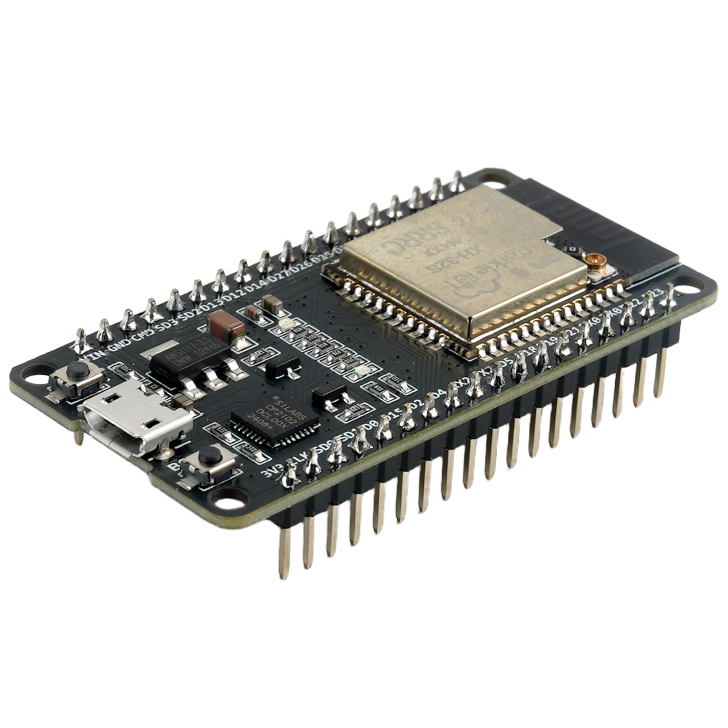

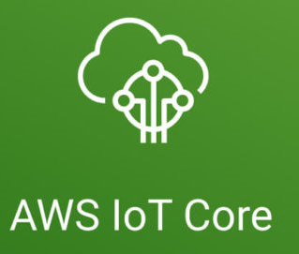
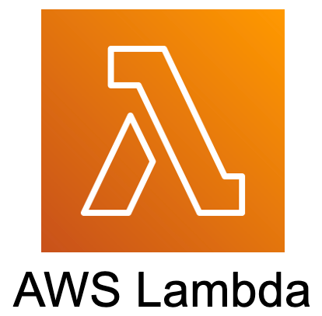
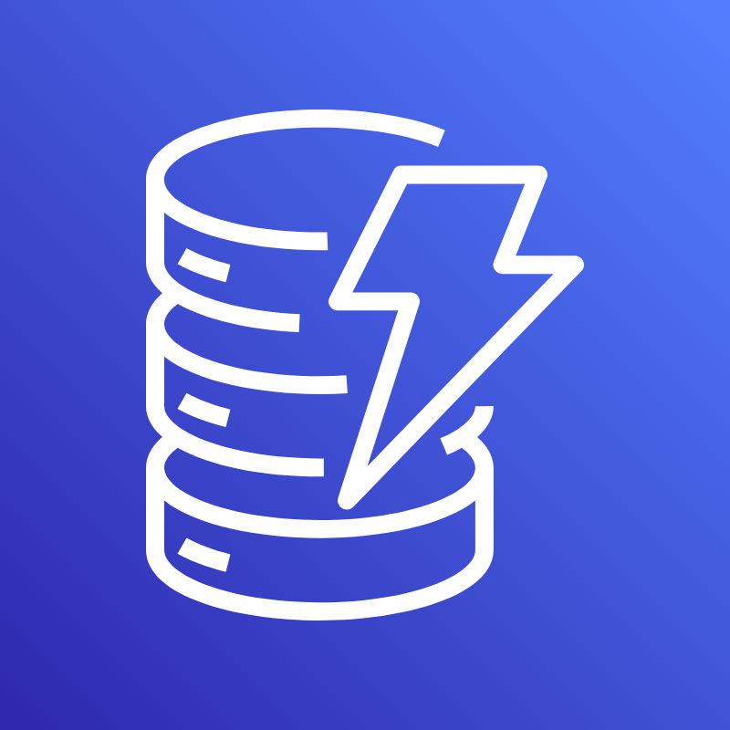
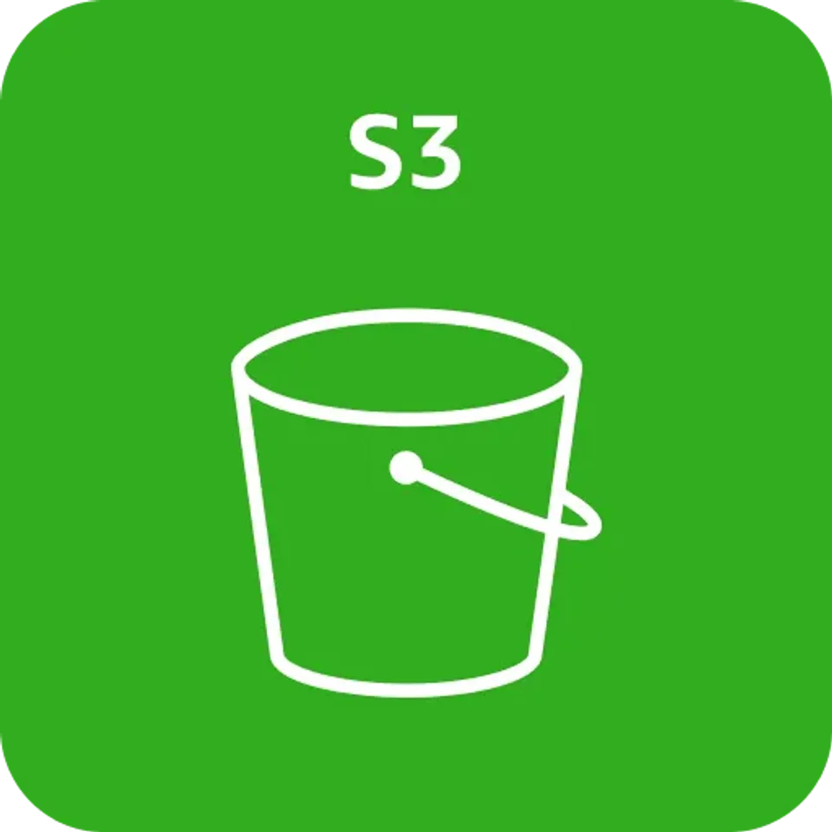
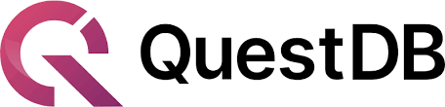
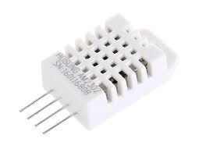
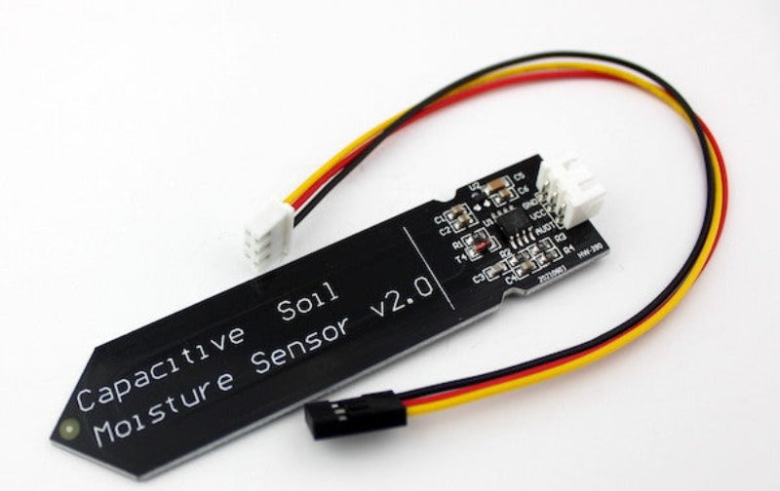
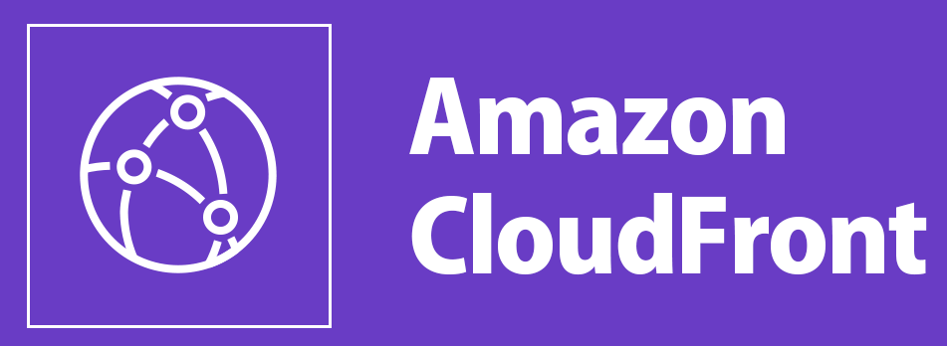




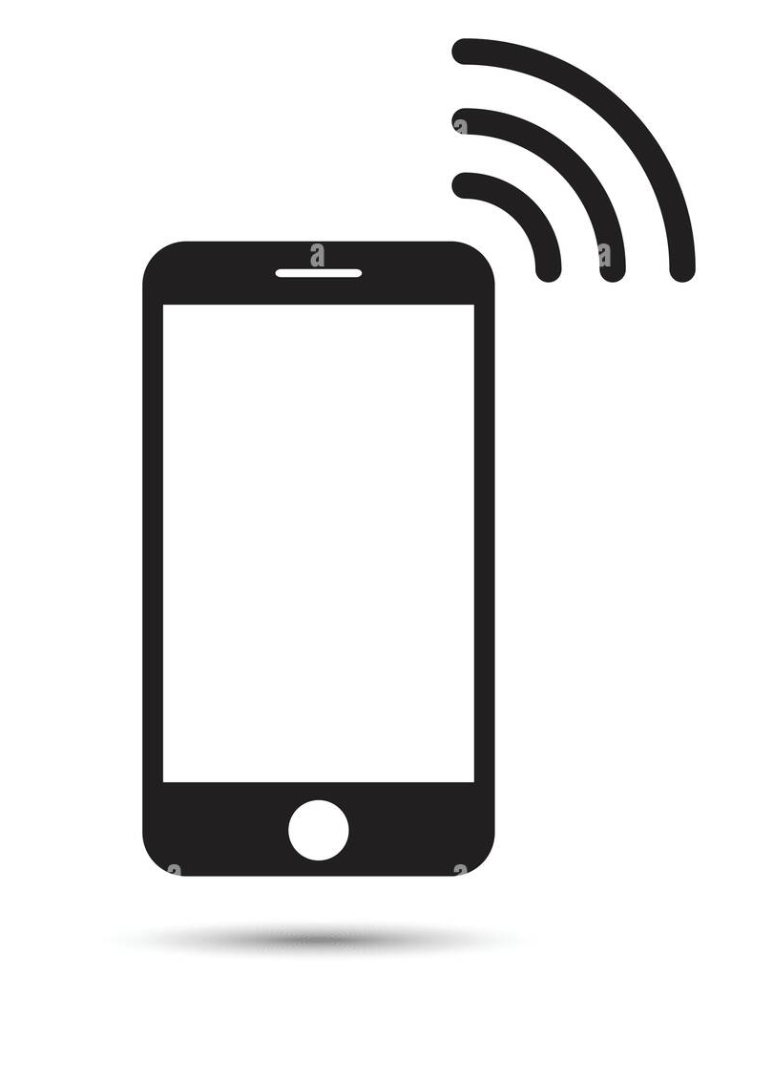
Telemetry trigger (IoT Rule)
MQTT over TLS
User & state data storage
Sensor data acquisition & network access
WiFi
IoT Rule: Store telemetry data
DynamoDB
Condition-based trigger
Time-series data ingestion
GPIO
Static data distribution
Time-series visualization
Alert delivery (Telegram Bot)
User alert & interaction

Slide 2
MQTT over TLS
Sensor data acquisition & network access
WiFi
IoT Rule: Store telemetry data
GPIO
Static data distribution

